Slide 1
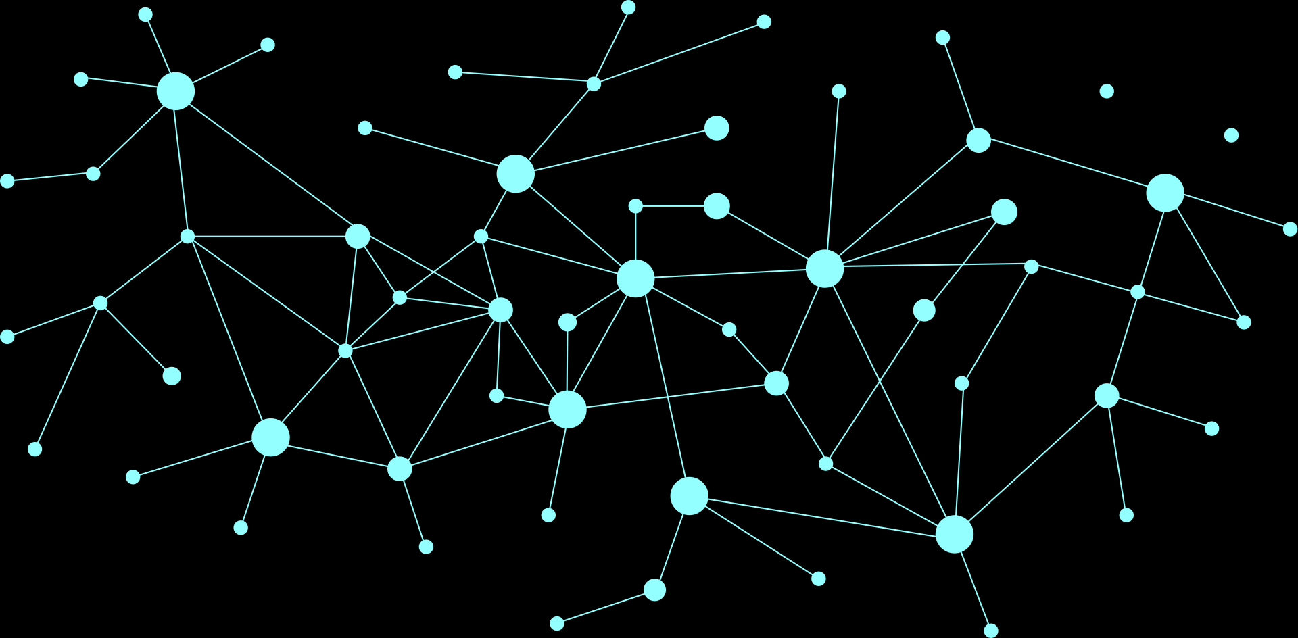


CAPSTONE PROJECT GROUP 6
Multi-Agent Crisis Response System
Capstone Project – Final Presentation
ALY 6980 – NANDA Capstone Project
Prepared By (Group 6): Kishan Preetam Kommana, Tanvi Kadam, Priyanka Raghunathan, Hanifa Logose, Feiyang Chen, Ruizhe Zhang, Shilin Wang
Under the Guidance of Dr. Hema Seshadri

Slide 2




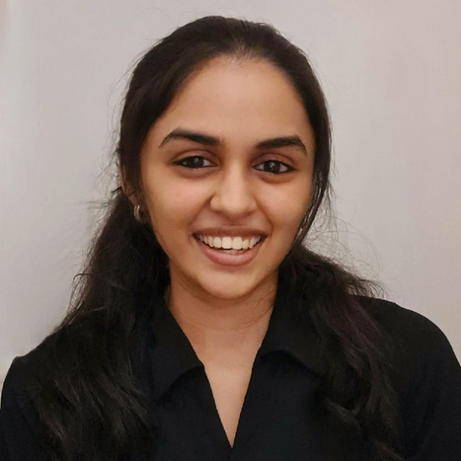
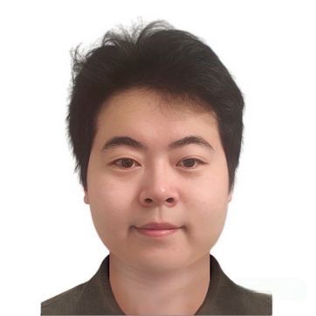
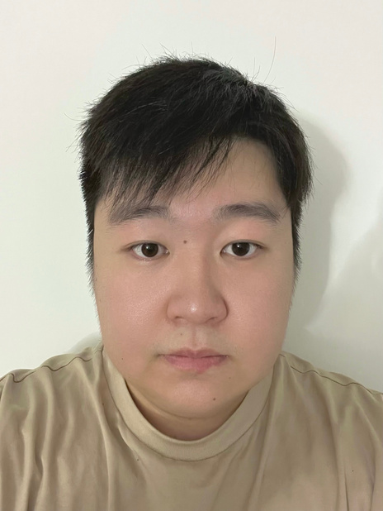
TEAM MEMBERS
Kishan Preetam Kommanna
Tanvi Kadam
Hanifa Logose
Kommana.k@northeastern.edu
kadam.ta@northeastern.edu
logose.h@northeastern.edu
Feiyang Chen
Priyanka Raghunathan
Shilin Wang
Ruizhe Zhang
chen.feiya@northeastern.edu
raghunathan.p@northeastern.edu
wang.shili@northeastern.edu
zhang.ruizhe@northeastern.edu

Slide 3

Introduction
What We Built:
AI-Powered Multi-Agent System for Flash Flood Emergency Response
A intelligent crisis response system using autonomous AI agents that work together to:
Detect and analyze flash flood threats in real-time
Coordinate emergency response across multiple teams
Optimize resource allocation and deployment
Enable rapid decision-making during critical moments
Built to reduce response time and save lives during critical flash flood events
Why Multi-Agent AI Architecture?
✓ Autonomous operation - no manual bottlenecks
✓ Parallel processing - multiple tasks simultaneously
✓ Adaptive intelligence - learns and improves responses
✓ Seamless collaboration - agents communicate and coordinate

Slide 4



The Crisis Response Challenge
Current Crisis Response Systems Face Critical Limitations
Slow Response Times
Poor Coordination & Communication
Inefficient Resource Allocation
Traditional systems rely on manual coordination and sequential decision-making
Delays in information processing during critical moments
Multiple agencies and responders operate in silos
Lack of real-time information sharing across teams
Static response protocols can't adapt to dynamic crisis scenarios
Suboptimal deployment of emergency resources

Slide 5

Agent Development Process
Development Journey: From Concept to Production
Phase 01
Phase 02
Phase 03
Phase 04
Selected NEST Framework
Modified framework to fit our multi-agent architecture needs
Designed 4-tier hierarchical architecture
Defined 10 specialized agent roles with unique capabilities
Created JSON-driven configuration system
Validated A2A communication protocols
Integrated Claude API for agent intelligence
Tested inter-agent coordination locally
Migrated to Linode Cloud Infrastructure
Deployed on g6-standard-4 instance (8GB RAM, 4 CPUs)
Automated deployment via single bash script

Slide 6
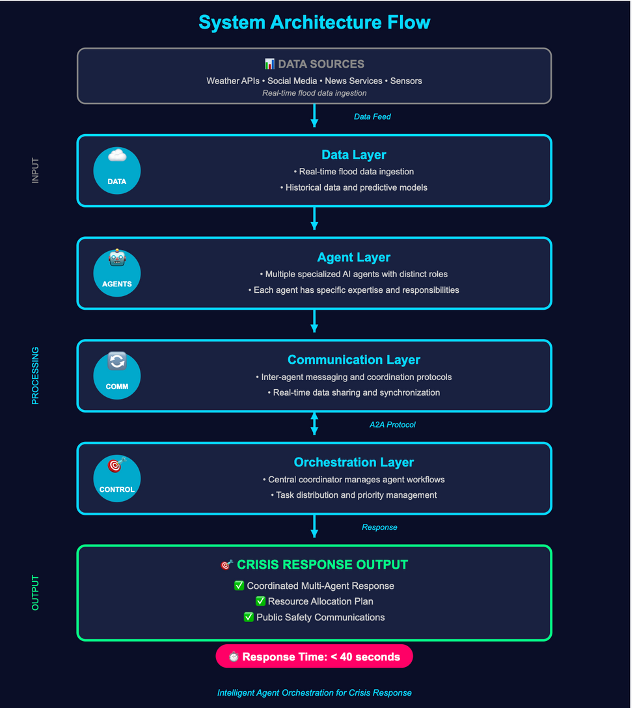




Multi-Agent System Architecture
Core System Layers
Agent Layer
Multiple specialized AI agents with distinct roles
Each agent has specific expertise and responsibilities
Communication Layer
Inter-agent messaging and coordination protocols
Real-time data sharing and synchronization
Orchestration Layer
Central coordinator manages agent workflows
Task distribution and priority management
Data Layer
Real-time flood data ingestion
Historical data and predictive models

Slide 7
Tier 1 & 2: Detection & Analysis
AI Agent Team
Tier 1: Detection Agents
📱 Social Media Sentinel - Monitors social platforms for real-time reports
🌦️ Environmental Monitor - Tracks weather, rainfall, and river gauges
📰 News Alert Scanner - Aggregates official weather service alerts
Tier 2: Analysis Agents
🎯 Situation Assessor - Correlates data to determine flood severity
🗺️ Resource Mapper - Tracks available emergency resources
🧠 Pattern Analyzer - Learns from historical data for predictions

Slide 8
Tier 3 & 4: Response & Command
AI Agent Team
Tier 3: Response Agents
🚑 Emergency Dispatcher - Coordinates first responder deployment
📢 Public Communicator - Distributes evacuation alerts and safety messages
🏥 Medical Triage - Manages hospital readiness and medical priorities
Tier 4: Command Agents
🎛️ Mission Control - Central orchestration, strategic decisions, unified coordination

Slide 9
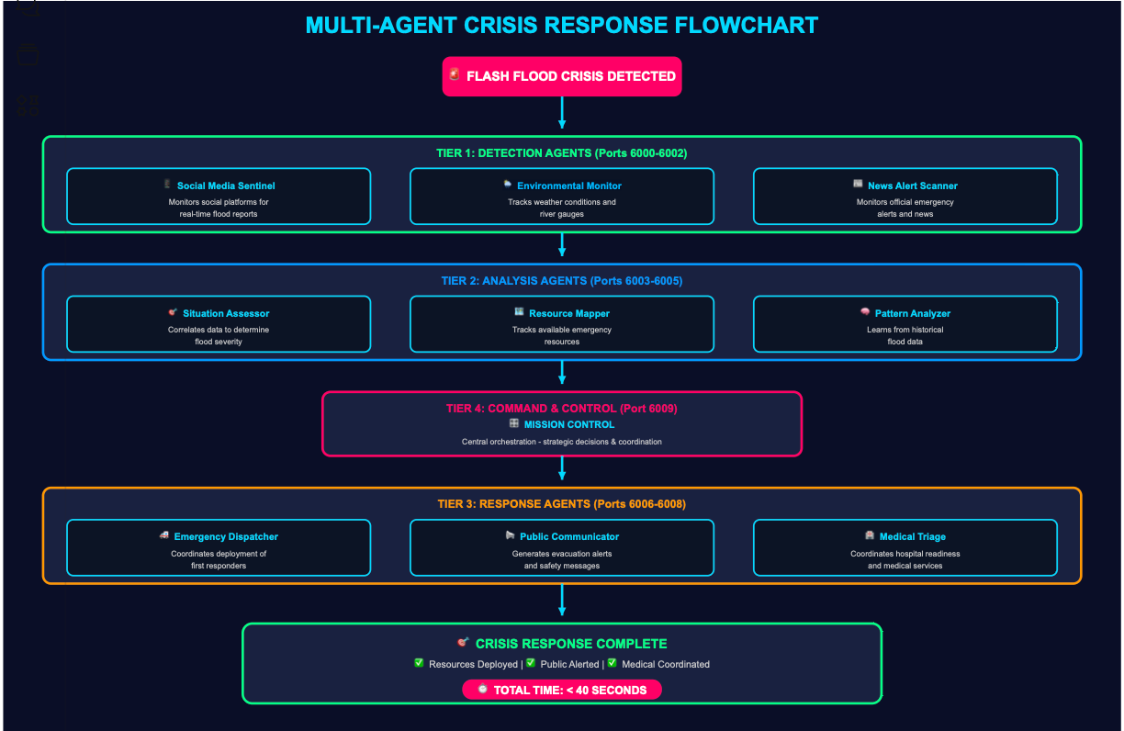
ALL TIERS WORKING TOGETHER AS A SYSTEM

Slide 10
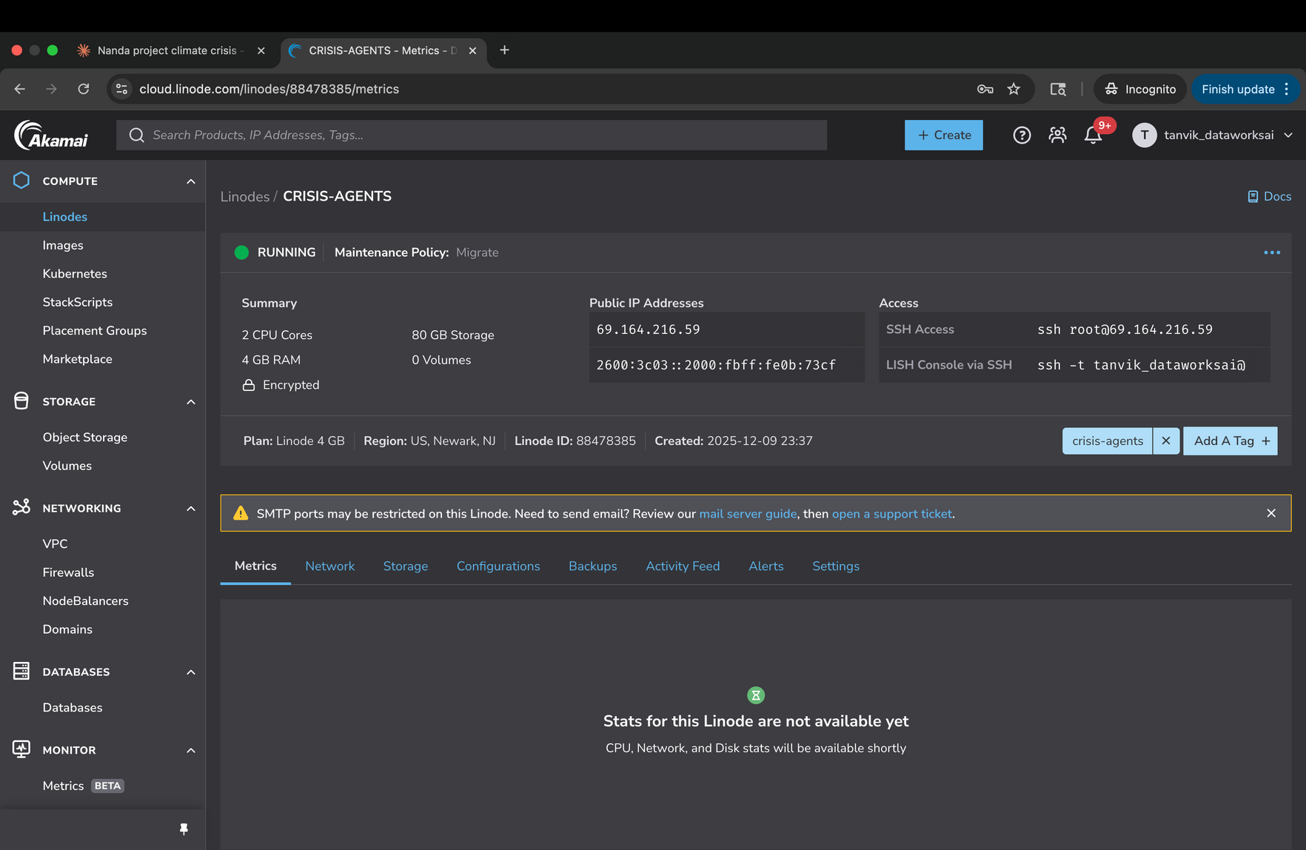
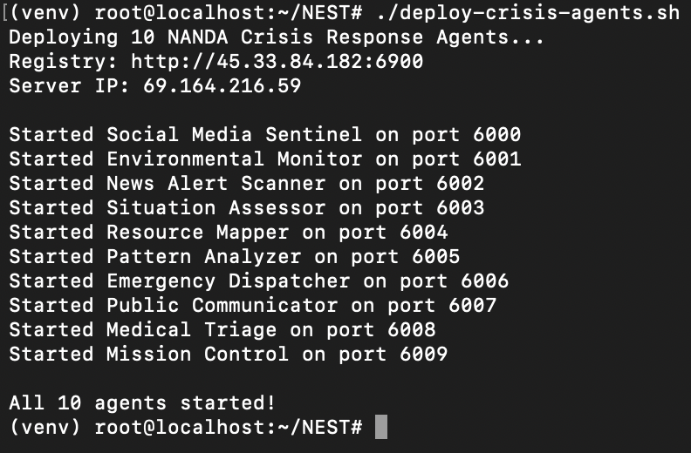
Production Deployment & Live System
From Infrastructure to Execution: Our Multi-Agent System in Action
Section 1: Live Server Status
Section 2: Deployment Execution

Slide 11
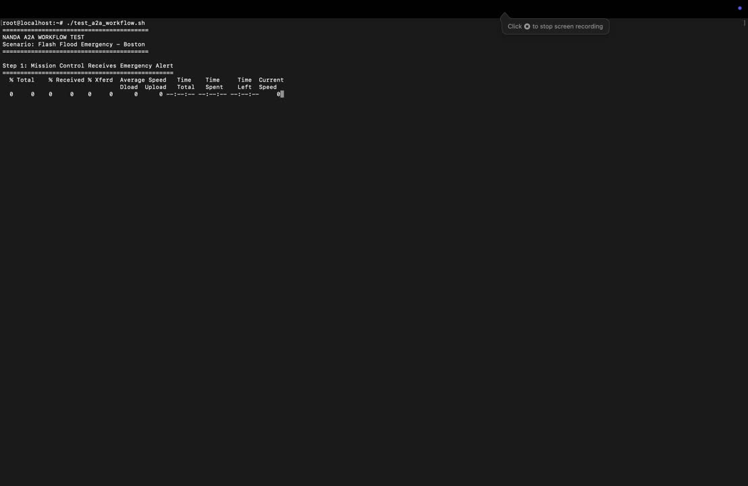
A2A Communication Protocol

Slide 12
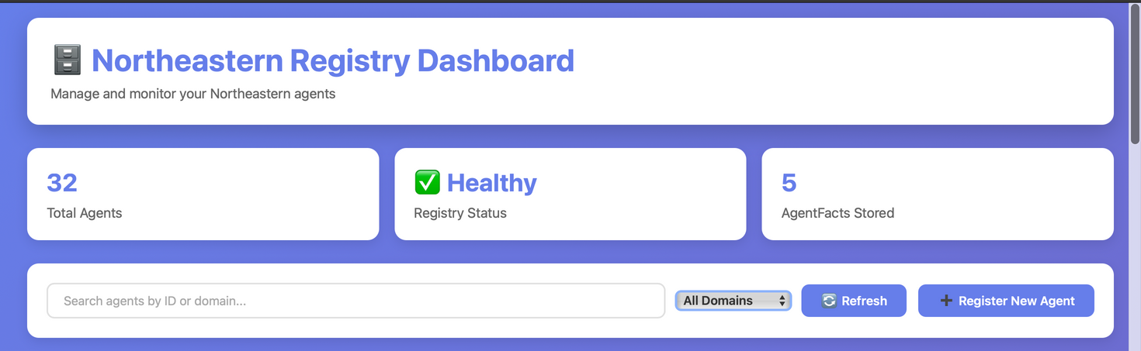
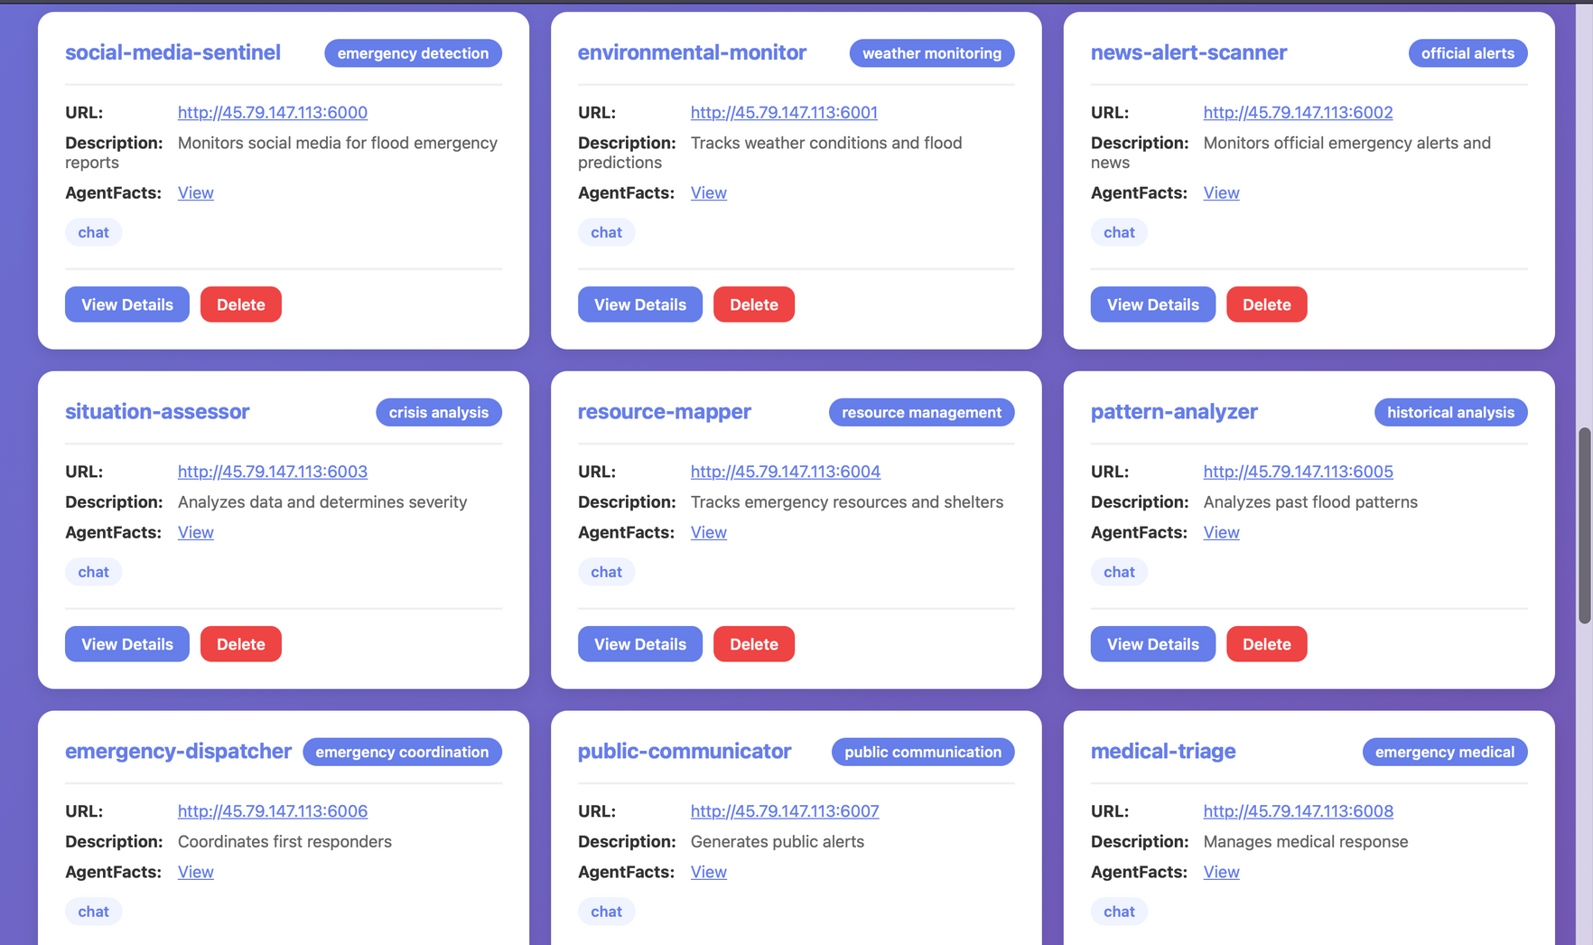
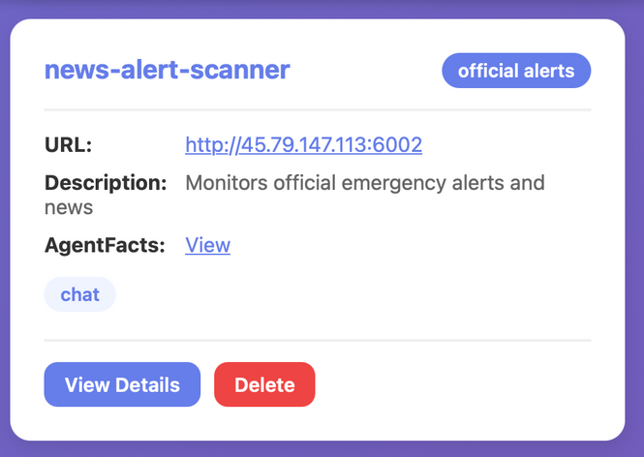
NANDA Registry - Agents Deployed
CRISIS RESPONSE 10 AI Agents Live and Registered

Slide 13
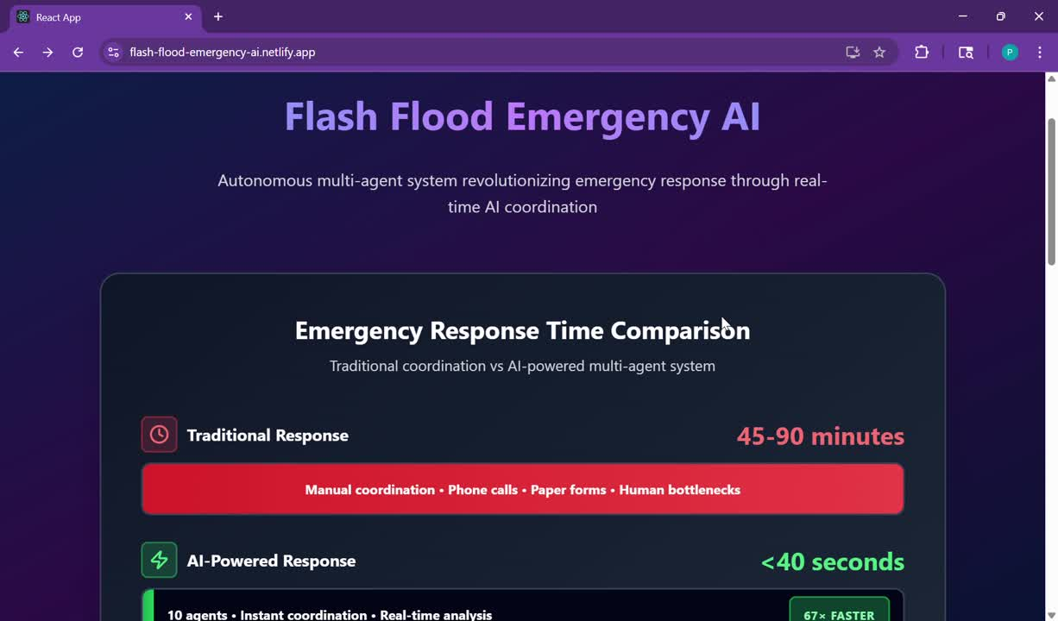
System Demo - Web UI in Action
Watch Our Multi-Agent System Respond to a Flash Flood Crisis

Slide 14
NEXT STEPS & FUTURE ENHANCEMENTS
Mobile Application
iOS/Android app for emergency responders in the field
Real-time alerts, mapping, and direct agent communication
Impact: Field responders access intelligence on mobile devices
Real-Time Data Integration via MCP
Connect to live weather APIs, social media streams, and GIS data sources
Replace simulated data with actual emergency feeds
Impact: Operational readiness for real-world deployment
Multi-Region Support
Expand beyond Boston to multiple cities nationwide
Region-specific resource databases and configuration system
Impact: Scalable platform for emergency agencies across the country
Domain-Specific Model Fine-Tuning
Fine-tune Claude models on emergency response data
Optimize for crisis-specific language and decision patterns
Impact: Enhanced agent performance with specialized AI models

Slide 15
Transforming Crisis Response with Multi-Agent AI
What We Delivered
A production-ready multi-agent system that coordinates flash flood emergency response in under 40 seconds—67-135x faster than traditional manual methods.

Slide 16
Conclusion
We built 10 AI agents that respond to flash floods in 40 seconds—135x faster than manual methods
Multi-agent architecture works for complex, time-critical coordination
Open-source collaboration accelerates innovation and strengthens communities
Deployment matters as much as development—automation is essential
Real-world impact: 40 seconds isn't just a metric—it saves lives
Cross-disciplinary teams create better solutions than individual expertise
Core insight: Intelligent systems work when agents collaborate seamlessly
Speed + Coordination + Intelligence = Lives Saved
We built a blueprint for intelligent crisis management

Slide 17
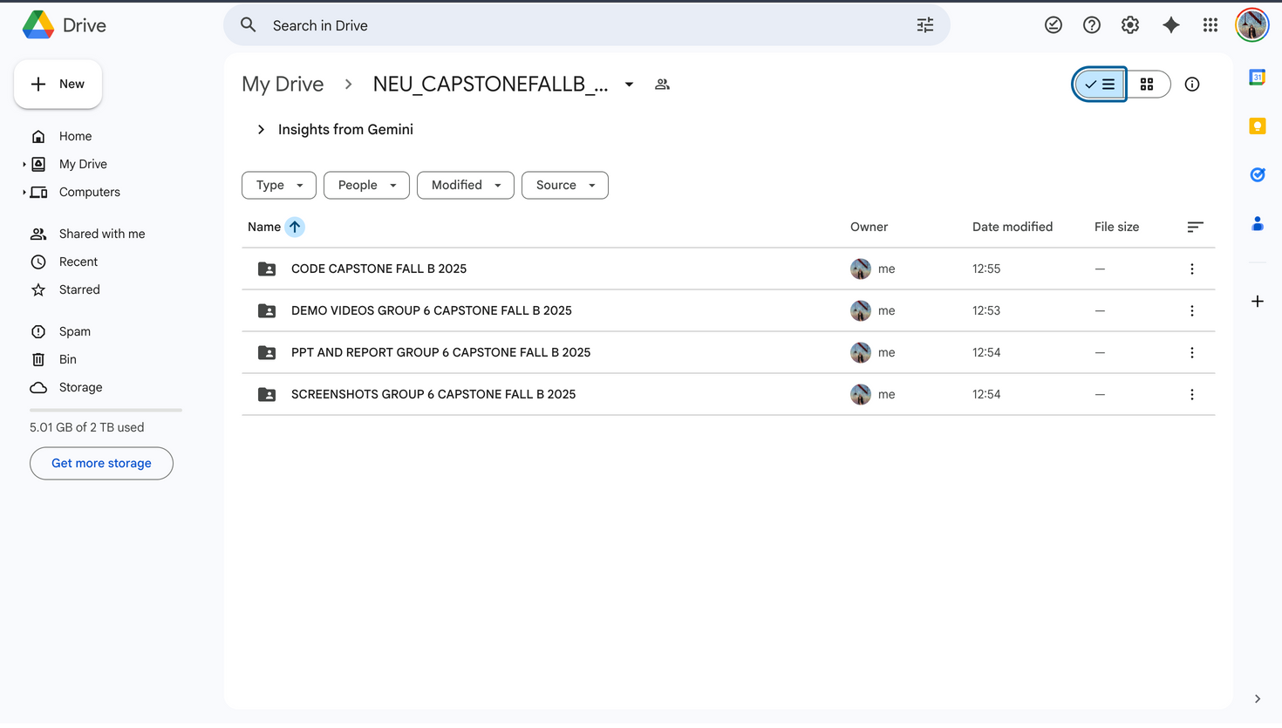
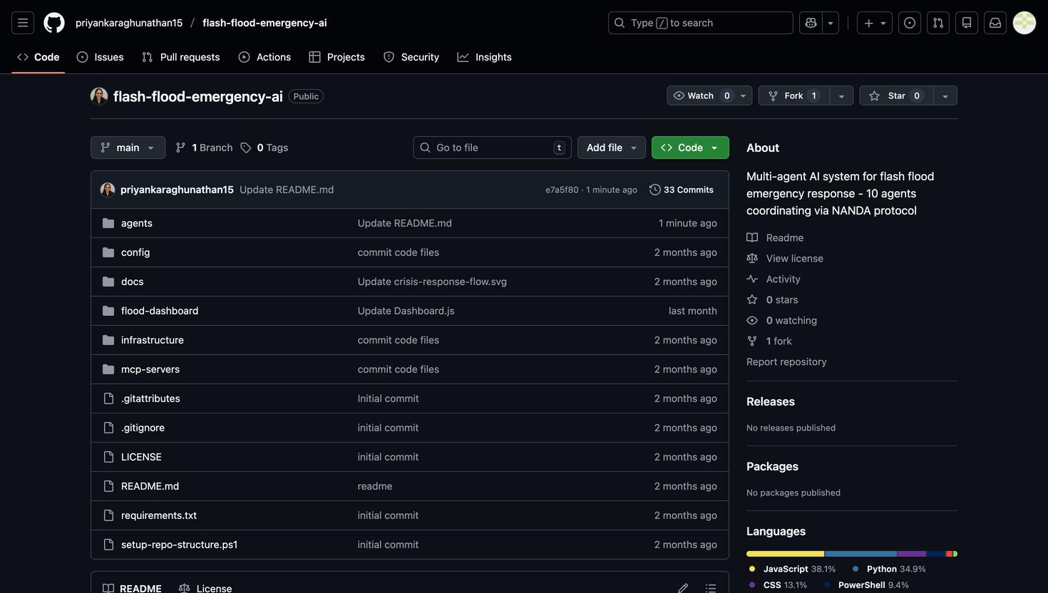
Links:
Group 6 GitHub Repo Link: https://github.com/priyankaraghunathan15/flash-flood-emergency-ai
Group 6 Google Drive Link: https://drive.google.com/drive/folders/1A-OzVCkf8PPznL_fdbGQwyTPJ1FjbFcZ

Slide 18
Thank You 💙
Team Group 6 | ALY 6980 - NANDA Capstone Project
Under the guidance of Dr. Hema Seshadri

